Slide 1
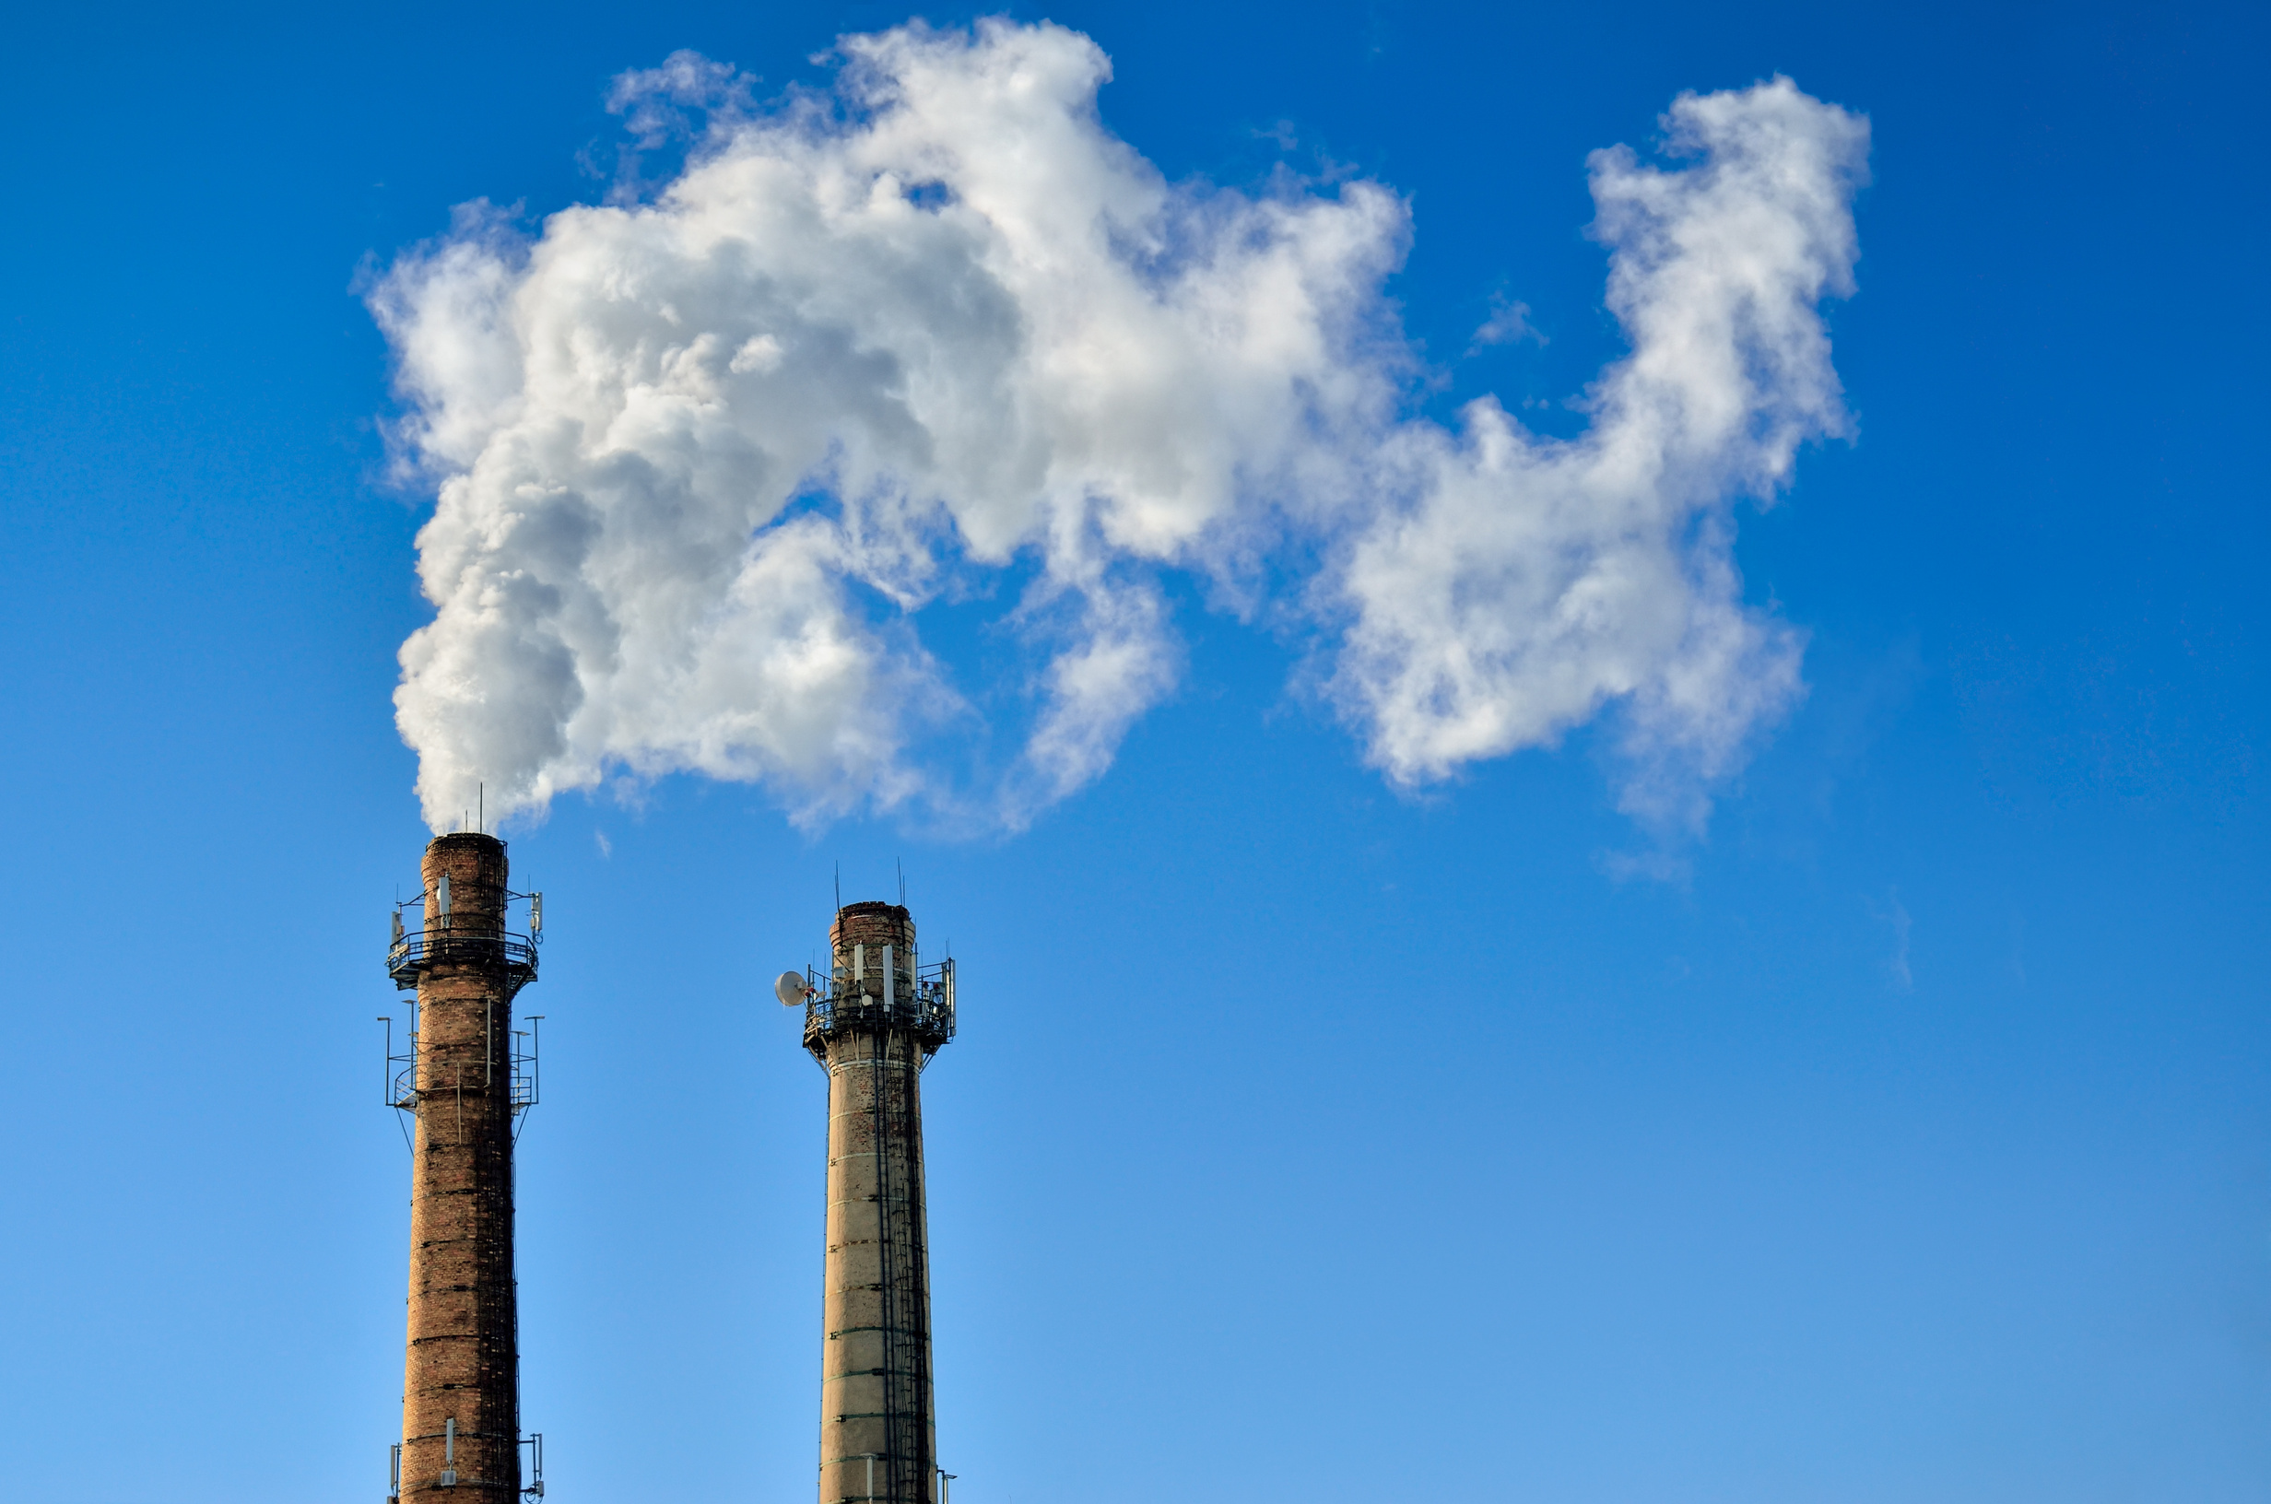


Uncover the Role of Greenhouse Gases in Your Neighborhood!
A Presentation by Team UDUPI

Slide 2
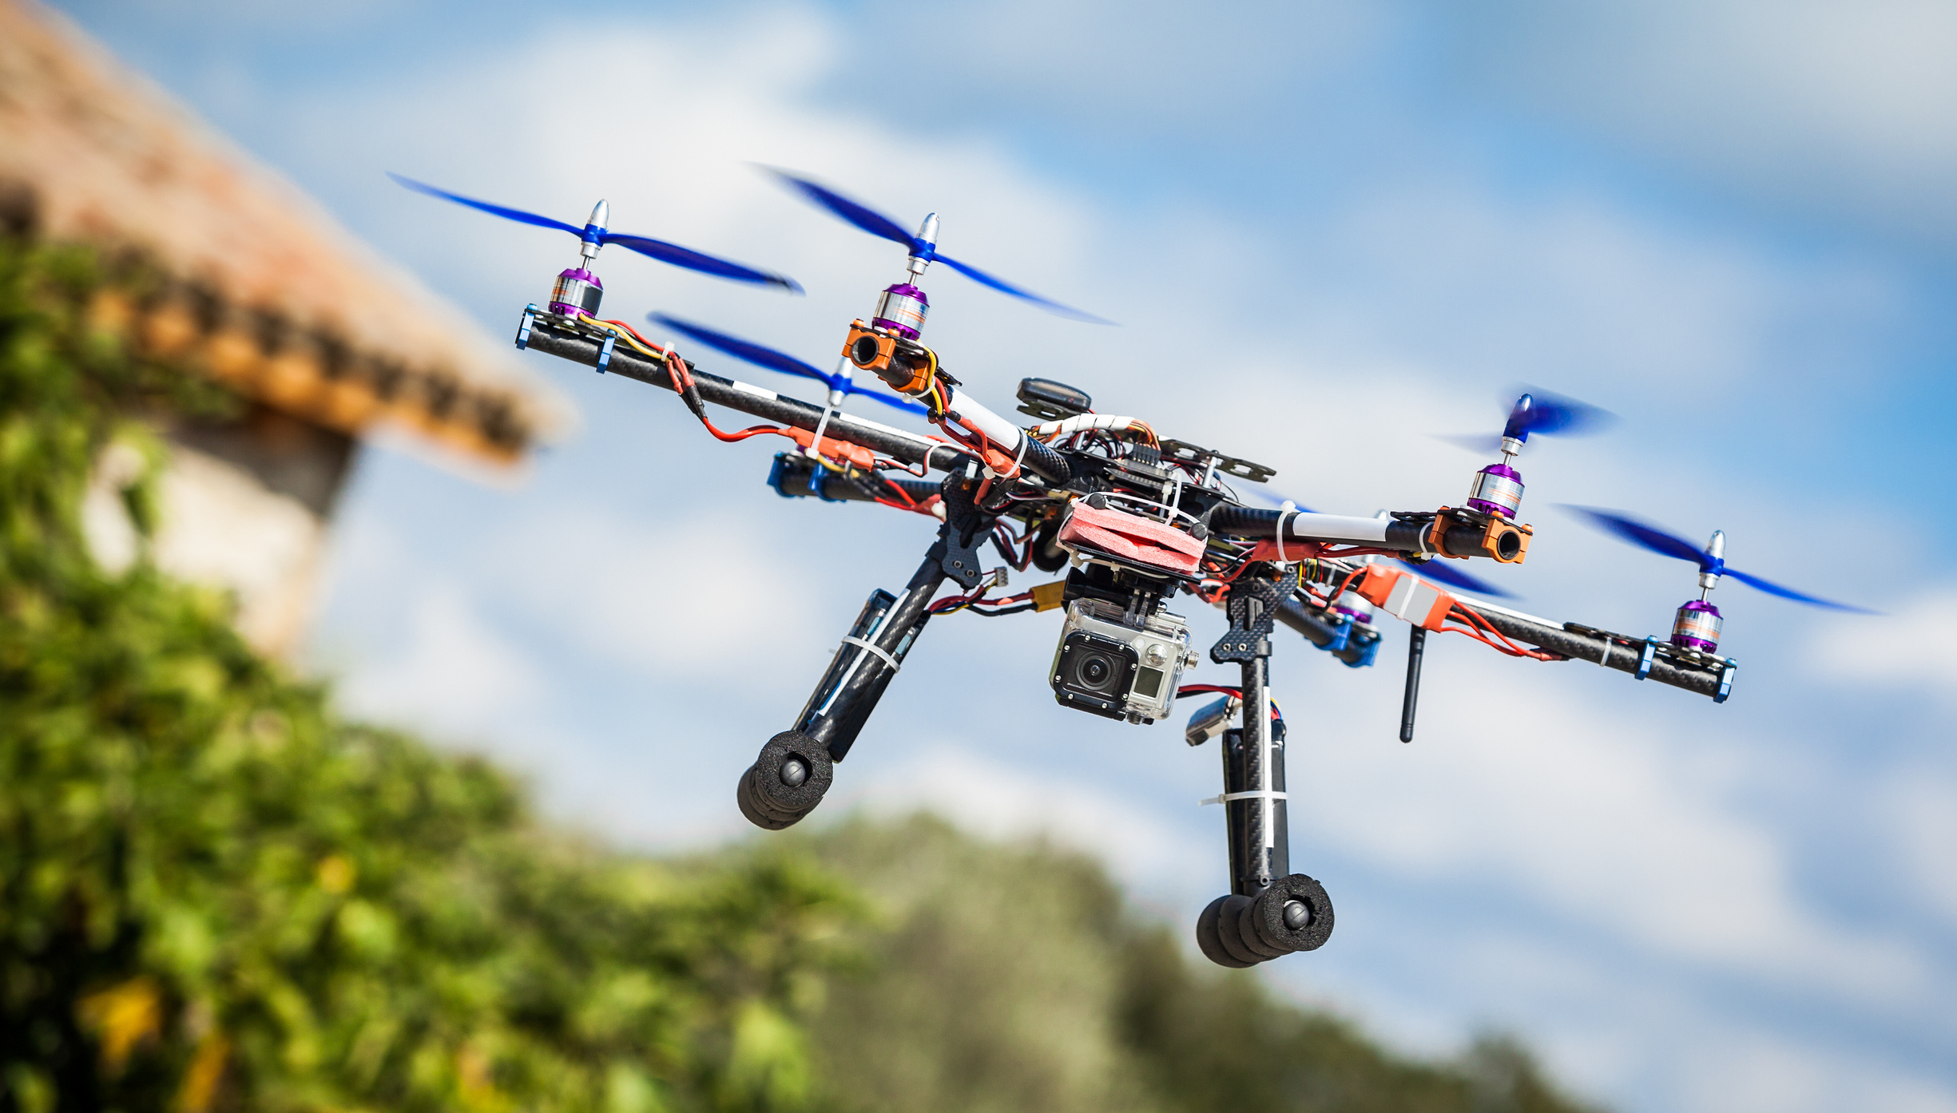

PROBLEM STATEMENT’S EXPLANATION
The way human activities produce greenhouse gases and how natural systems release and absorb them is a complex relationship that drives climate change. As the world works harder to tackle this issue, it’s more important than ever for both policymakers and the public to understand how these processes interact. Our challenge is to use a mix of satellite data and models to map both human-caused and natural greenhouse gas emissions, helping us better grasp how they contribute to a warming planet.

Slide 3
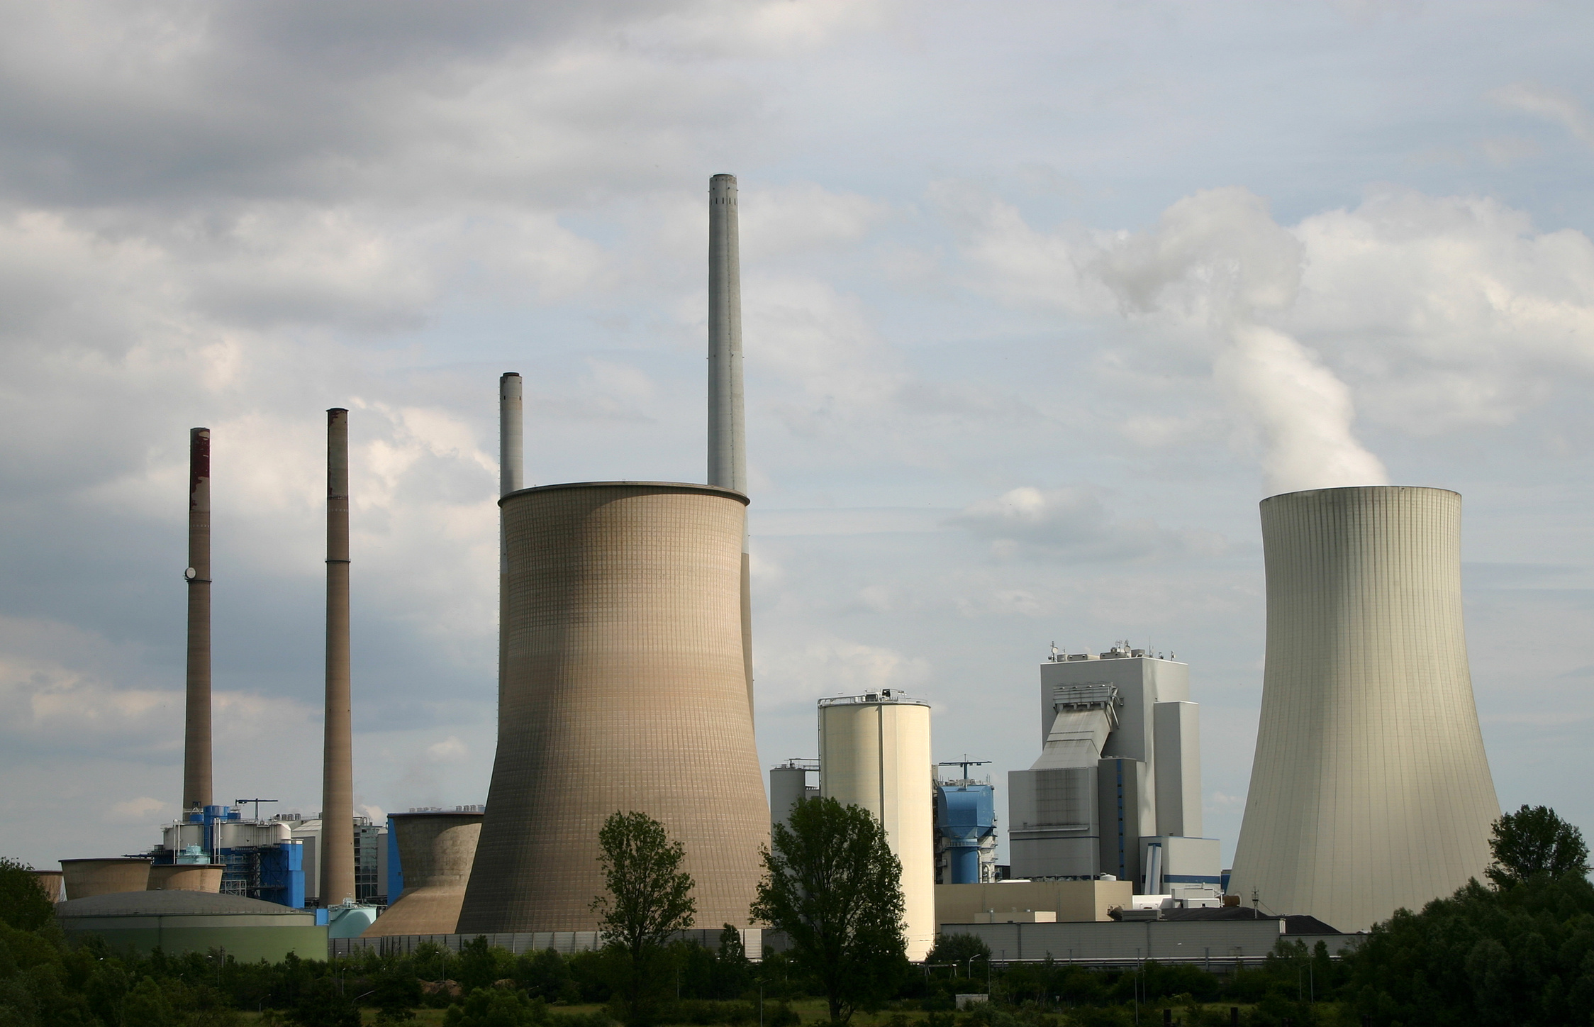
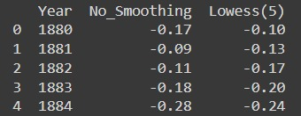

Our Solution to the Problem
Data Collection: The CanSat will be deployed to gather atmospheric data, including air quality index (AQI) and composition, with a focus on detecting greenhouse gases.
Data Segregation: The collected data will be manually analyzed and categorized into sources of greenhouse gases—whether human-made (industrial, vehicular emissions) or naturally occurring.
AI Integration: An AI model will be used to analyze this segregated data to identify any unusual patterns or abnormalities in greenhouse gas concentrations across different regions.
Leakage Detection: Based on the AI analysis, regions showing abnormal spikes in greenhouse gases will be flagged to investigate potential sources like industrial leakages or mass emissions.
Actionable Insights: Upon detecting such abnormalities, responsible authorities will be notified to take appropriate action and mitigate greenhouse gas emissions.

Slide 4

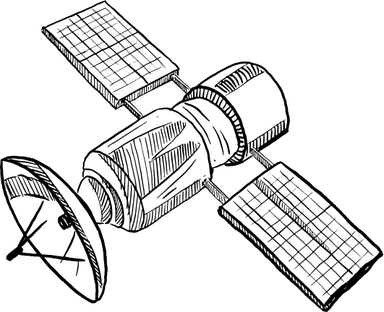
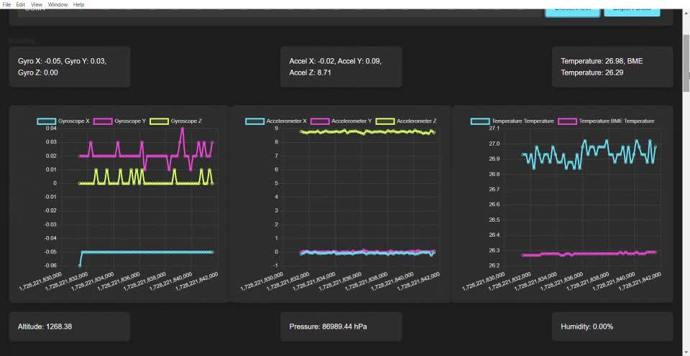

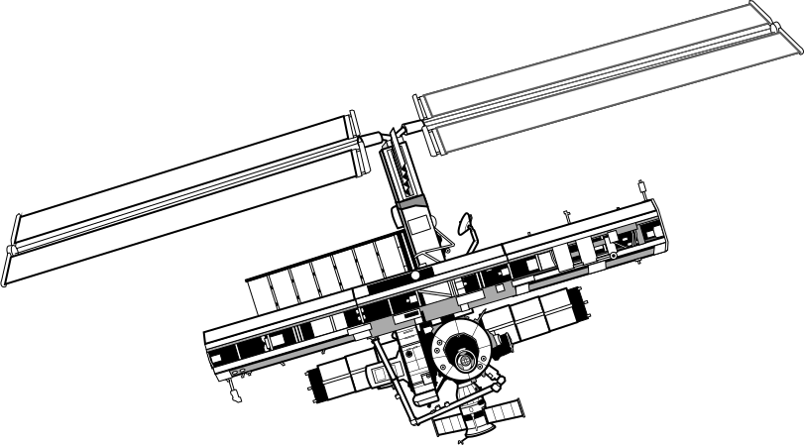
Graphical User Interface

Slide 5
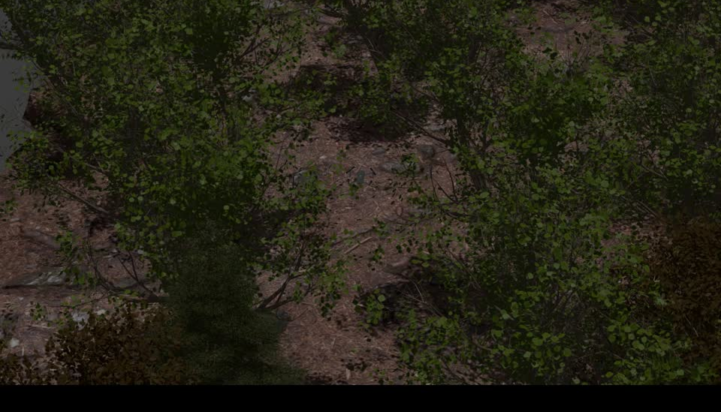

Slide 6






Feasibility and Viability
Technical Capability: Using a CanSat to collect atmospheric data is feasible as CanSats are widely used in similar educational and research-based projects. Sensors for detecting gases like CO₂, CH₄, and others are compact and easily integrated into the CanSat.
Manual Data Segregation: While manually categorizing the sources of greenhouse gases could be time-consuming, it is feasible if a clear criterion for distinguishing human-made vs. natural emissions is developed.
AI Model: Developing or training an AI model to detect abnormalities based on collected data is feasible. Existing machine learning algorithms can be applied to time-series data for anomaly detection, and training datasets could be sourced from previous studies.
Collaboration with Authorities: Partnering with environmental agencies or local authorities to act on the data is achievable if a solid framework for communication and data sharing is established.

Slide 7





Viability
Cost-Effective
Impact on Policy
CanSats are relatively low-cost, and cloud-based AI models are scalable, making this project financially viable even for student or research groups. Costs can be kept manageable by using open-source AI platforms and off-the-shelf sensors.
The project has a high potential for real-world application, as it could assist in early detection of greenhouse gas leaks or excessive emissions, allowing authorities to take action in a timely manner.
Scalability
Sustainability
This project can be expanded by increasing the number of CanSats deployed, covering wider geographical areas, and refining the AI model as more data is collected, making it scalable for long-term use.
By informing authorities about environmental risks, this project directly contributes to efforts to reduce greenhouse gas emissions, supporting sustainability goals.

Slide 8
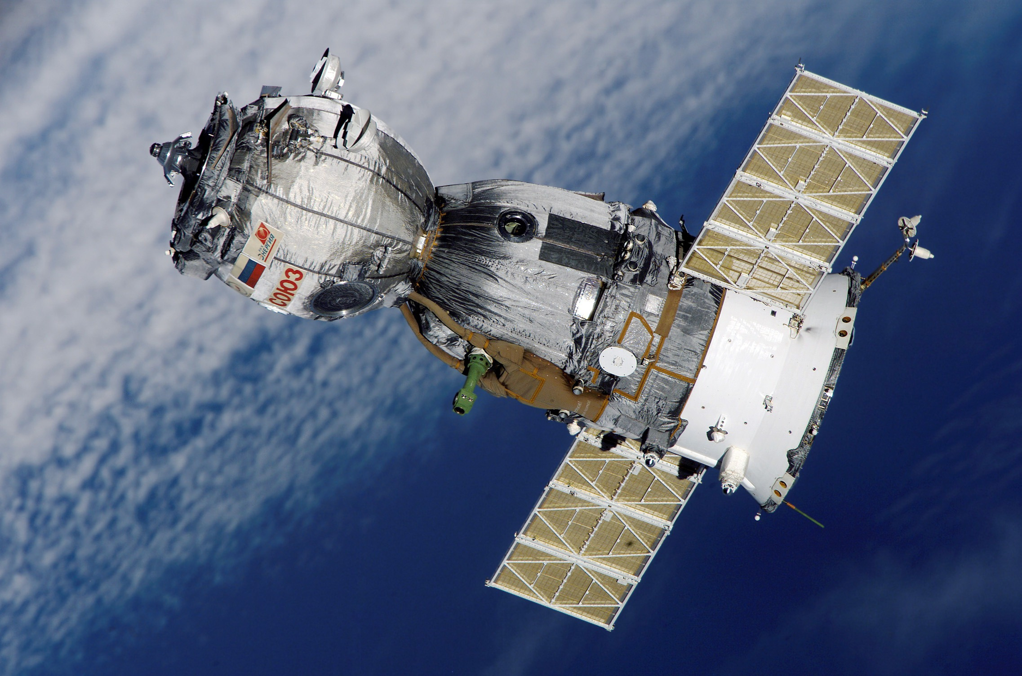
Potential Challenges
Data Accuracy and Calibration:
Challenge: The CanSat sensors need to be highly accurate and well-calibrated to detect trace levels of greenhouse gases. Variations in sensor quality could affect data reliability.
Mitigation: Use high-precision sensors and regularly calibrate them against known standards to ensure the accuracy of atmospheric data.
2. Segregation of Emission Sources:
Challenge: Manually distinguishing between human-made and natural greenhouse gas sources could be complex and time-consuming, especially when multiple overlapping sources are present.
Mitigation: Develop clear guidelines and possibly automate part of the segregation process using advanced algorithms or pre-trained AI models.
3. AI Model Training and Generalization:
Challenge: The AI model may require extensive training with large, diverse datasets to detect abnormalities accurately. If the model is not properly trained, it might give false positives or miss significant events.
Mitigation: Use high-quality datasets for training the model and periodically update the model with new data to improve its ability to generalize across different regions.

Slide 9



Potential Challenges
4. Environmental Variables:
Challenge: Weather conditions, altitude, and local geography could affect gas concentrations, making it difficult to establish normal baselines for detecting anomalies.
Mitigation: Consider incorporating environmental factors into the AI model and collecting long-term baseline data to account for such variations.
5. Communication with Authorities:
Challenge: Promptly informing responsible authorities about detected issues may be challenging due to bureaucratic delays or lack of proper communication channels.
Mitigation: Establish formal partnerships with environmental agencies beforehand and agree on protocols for sharing data and escalating potential issues.
6. Funding and Resources:
Challenge: Sourcing funds for sensors, AI development, and operational costs could be difficult for a large-scale deployment.
Mitigation: Seek collaborations with research institutions, governmental organizations, or environmental bodies that could provide funding or resources for the project.

